Slide 1

Do Crimes Have Patterns?
A Case Study on Chicago Crime Dataset
Song Liu (song.liu@bristol.ac.uk)

Slide 2
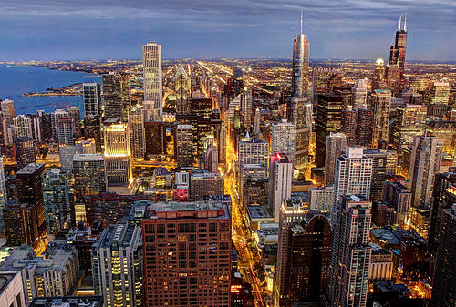
City of Chicago

Slide 3
Chicago Needs Your Help!
Chicago’s crime rate is higher than US average.
Chicago was responsible for nearly half of 2016's increase in homicides in the US.
Understanding patterns of crimes help the city deploy police force more rapidly.
The city recently released a dataset recording locations/types of crimes in Chicago.

Slide 4
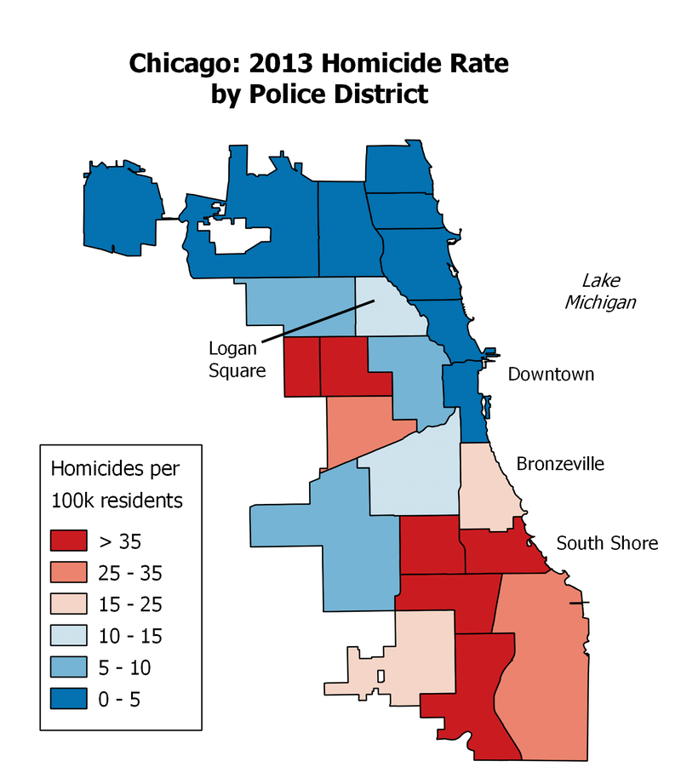
Geo Patterns of Crime
Can we see any geological patterns from our dataset?
Wiki: Crime in Chicago

Slide 5
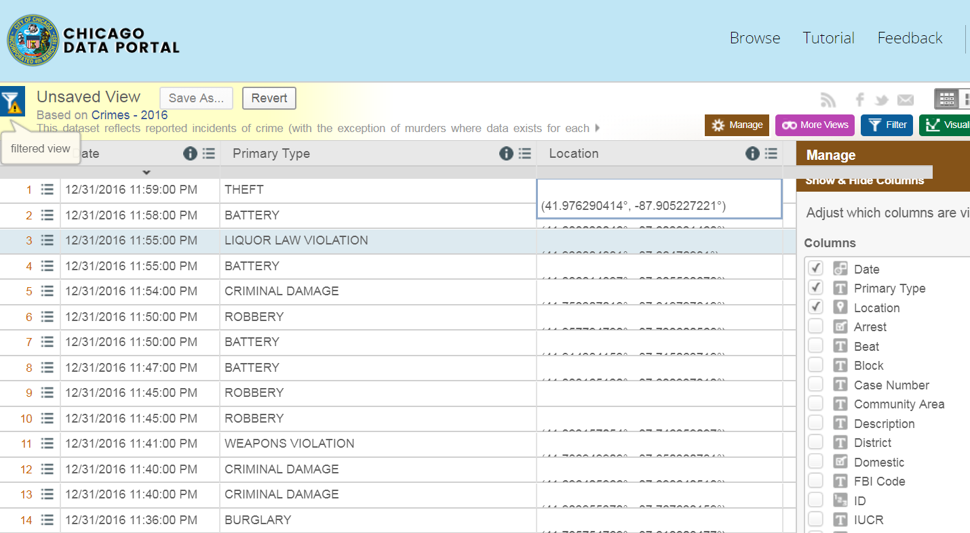
Data Format
Three most useful columns:
Date, Type (of Crime), Location

Slide 6
Questions
Analyze the dataset, and answer
Do crimes happen uniformly in Chicago?
If not, can you locate “crime epicenters” so we can mobilize police force more efficiently in the city.
Notes:
Uniform means one location has the exact chance of crime happening comparing to the other location.

Slide 7
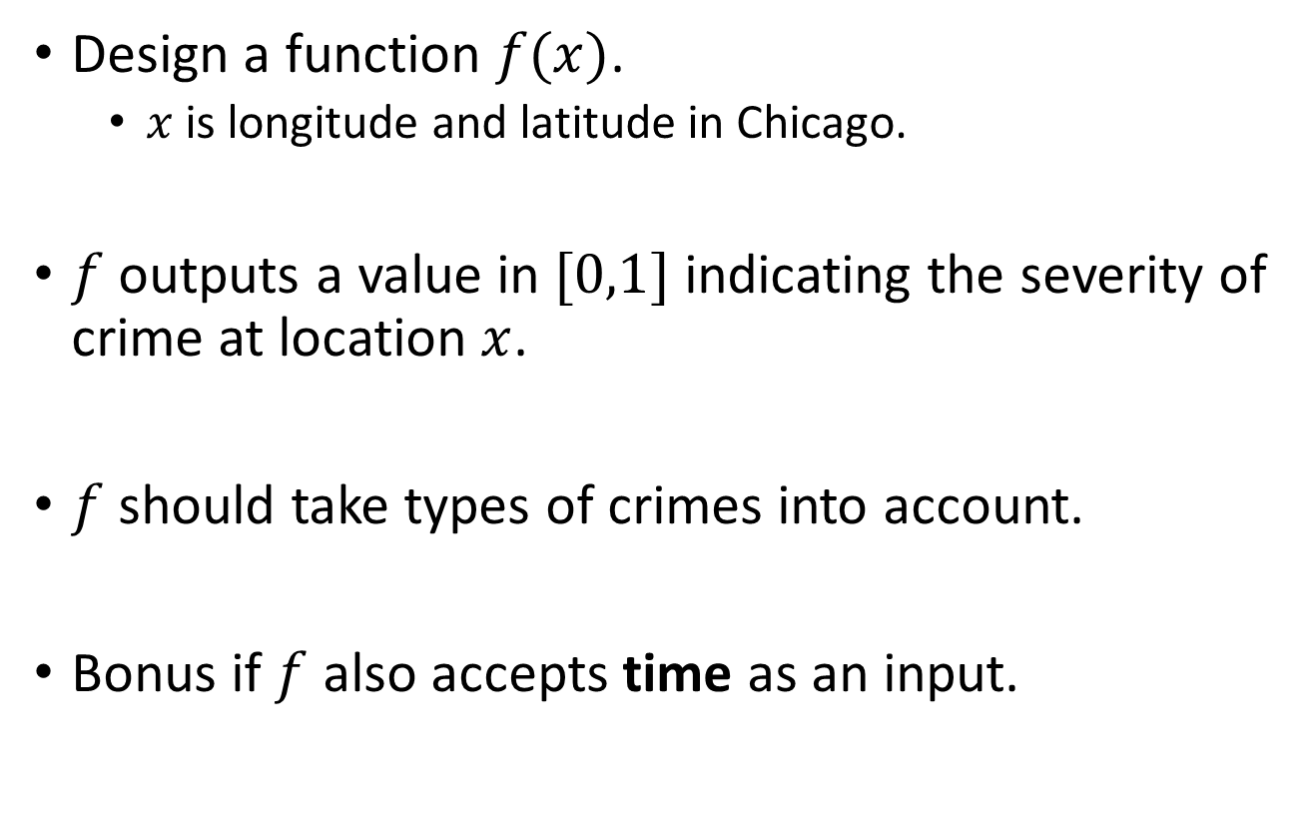
Questions (Continued)
Design a function $f(x)$.
$x$ is longitude and latitude in Chicago.
$f$ outputs a value in $[0,1]$ indicating the severity of crime at location $x$.
$f$ should take types of crimes into account.
Bonus if $f$ also accepts time as an input.

Slide 8
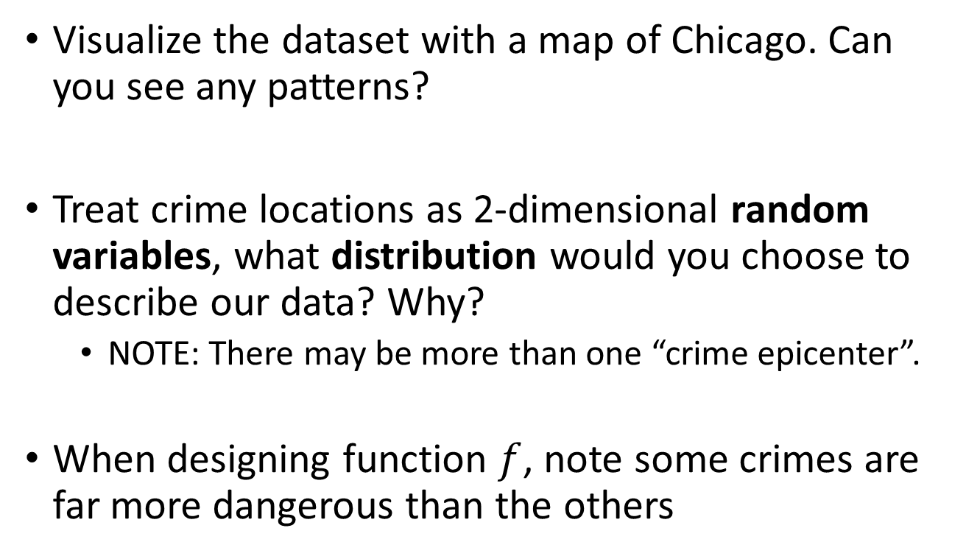
Hints:
Visualize the dataset with a map of Chicago. Can you see any patterns?
Treat crime locations as 2-dimensional random variables, what distribution would you choose to describe our data? Why?
NOTE: There may be more than one “crime epicenter”.
When designing function $f$, note some crimes are far more dangerous than the others

Slide 9
Useful Links
https://en.wikipedia.org/wiki/Mixture_model
https://en.wikipedia.org/wiki/Expectation%E2%80%93maximization_algorithm

